Slide 1
VS Code For Mac
Install and tutorial

Slide 2
Install vs code for mac

Slide 3
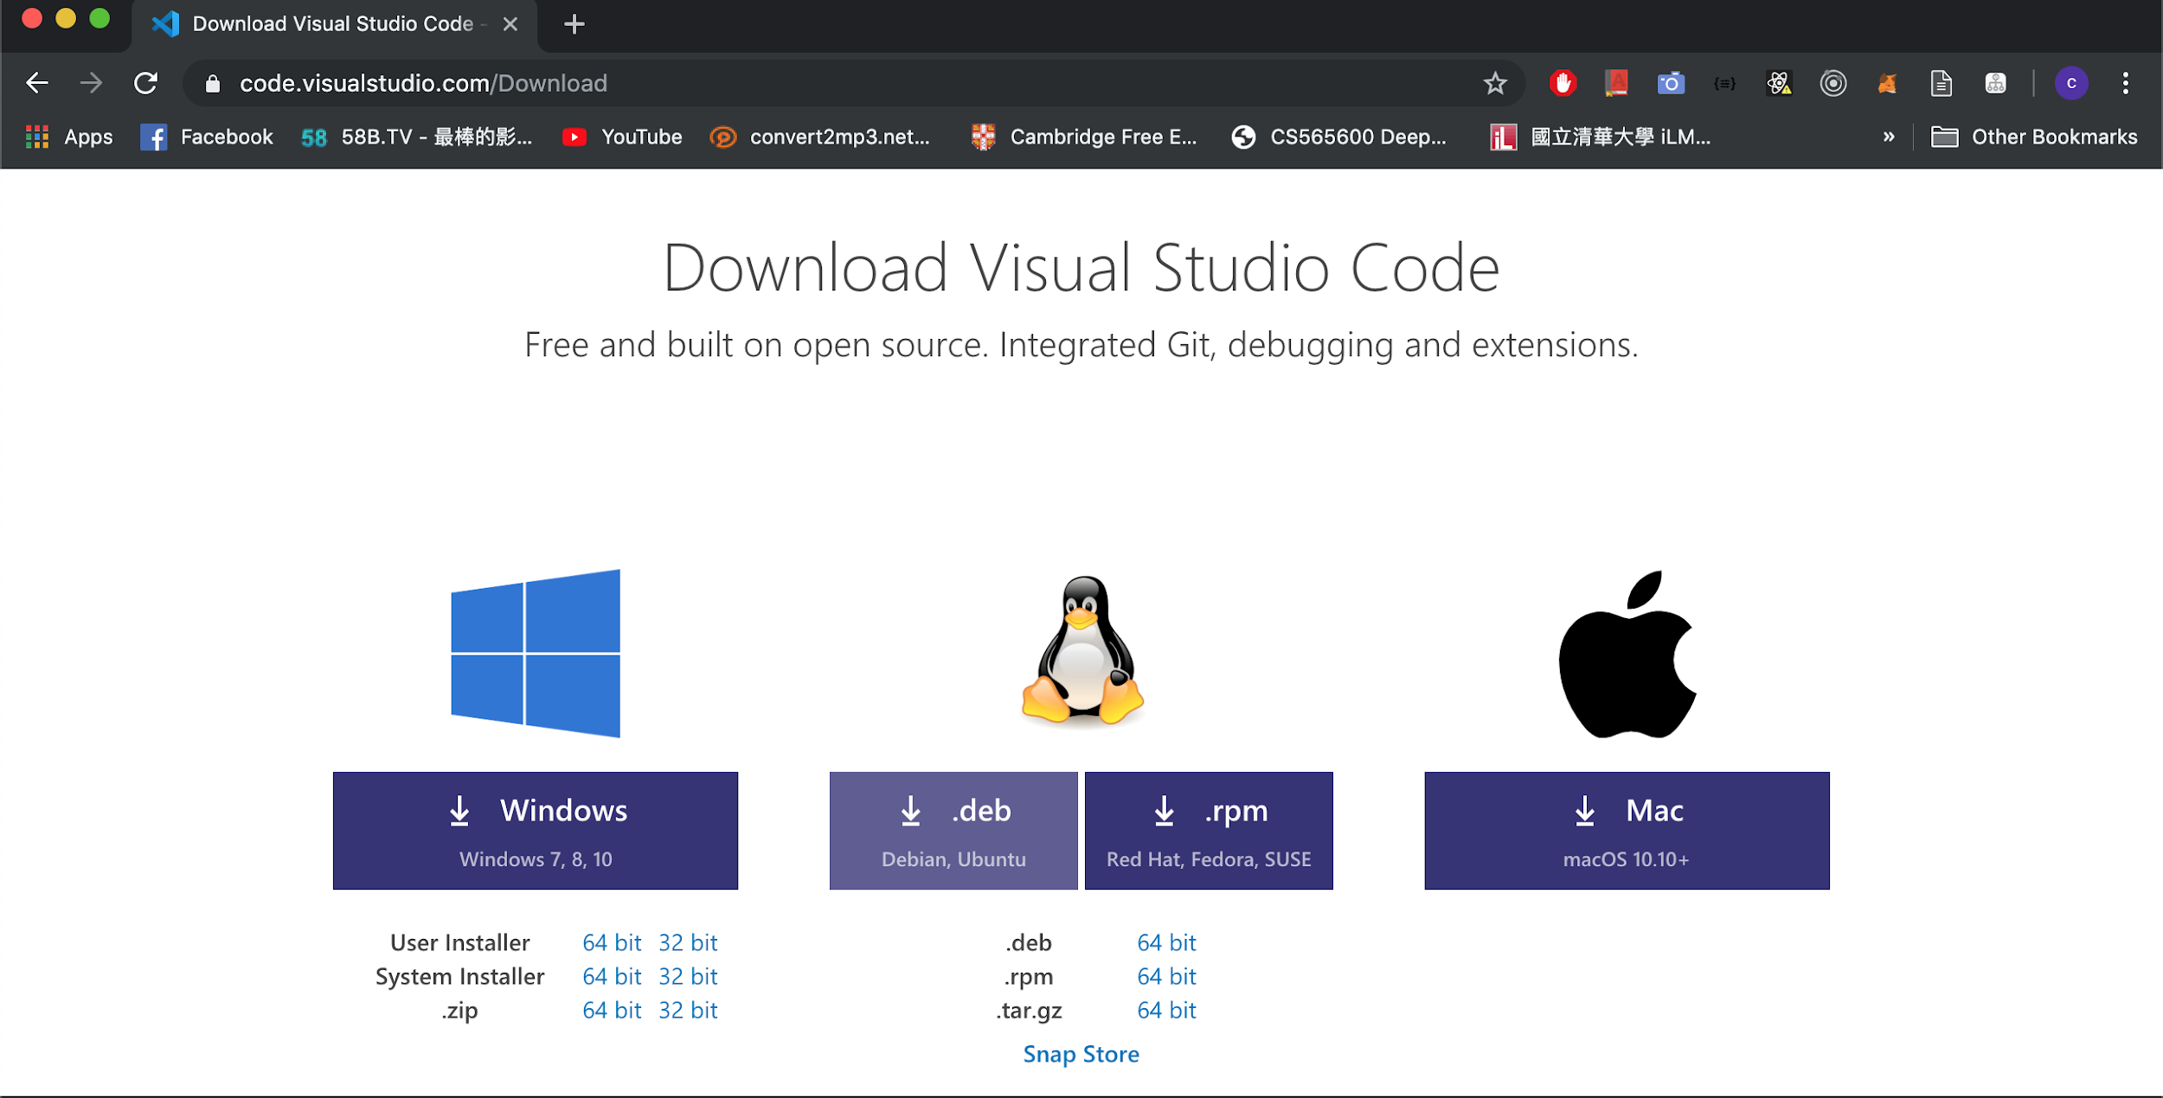
Install vs code for mac
Step1: Enter vs download page
https://code.visualstudio.com/download

Slide 4
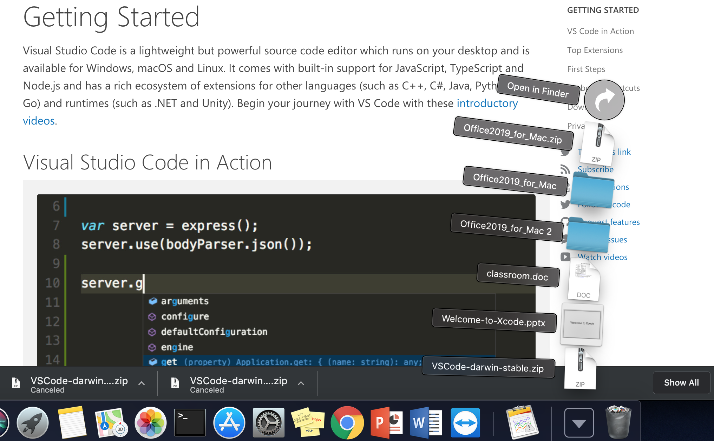
Install vs code for mac
Step2: Open vscode-darwin-stable.zip to install
2.
1.

Slide 5
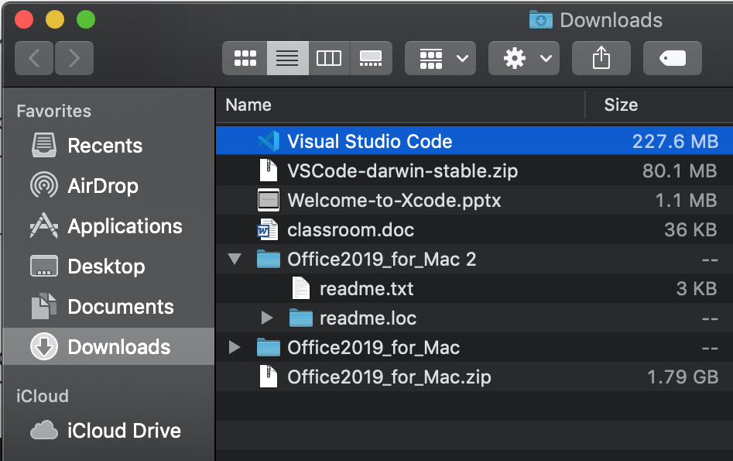
Install vs code for mac
Step3: Open Vscode

Slide 6
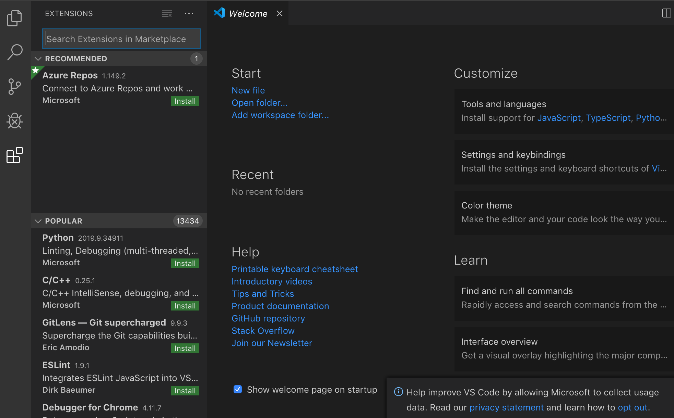
Install vs code for mac
Step4: Install C/C++ plugin
Final Result

Slide 7
Vs code usage

Slide 8
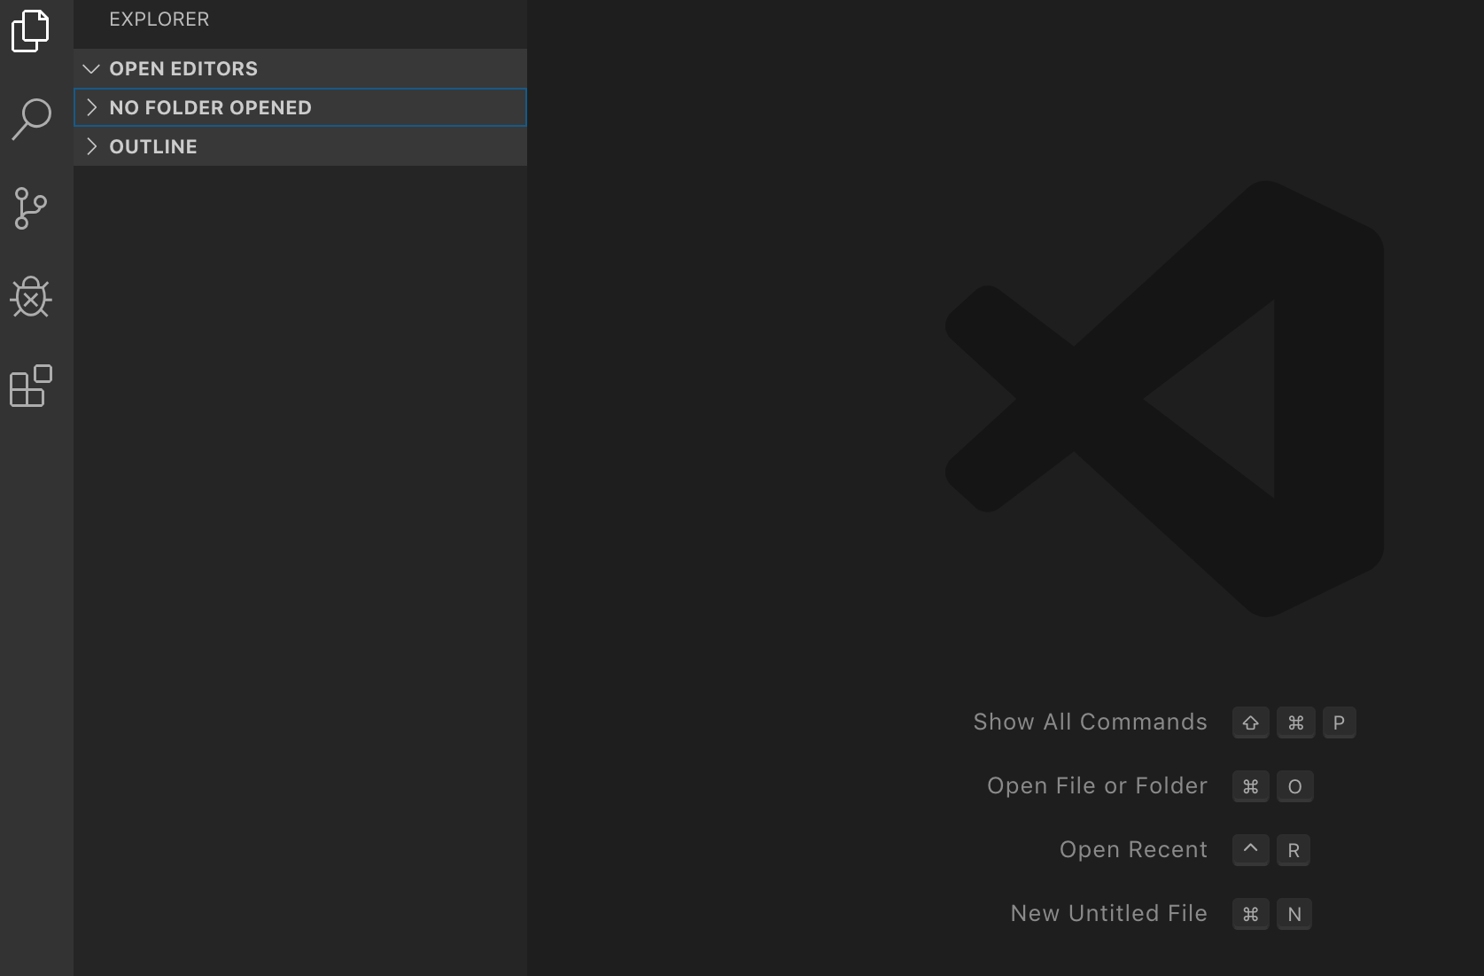
Vs code usage
Step1: Create new file (using “command + N”)

Slide 9
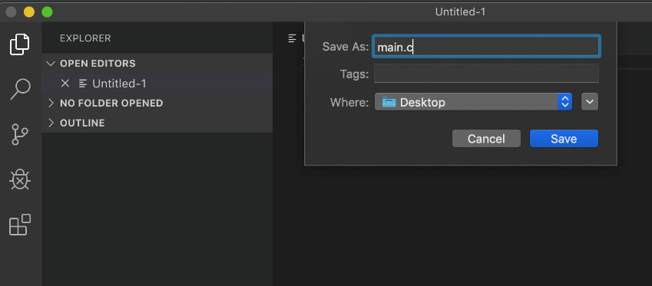
Vs code usage
Step2: Save file to *.c (using “command + s”)
1. file name
2. choose path to save
3. save file

Slide 10
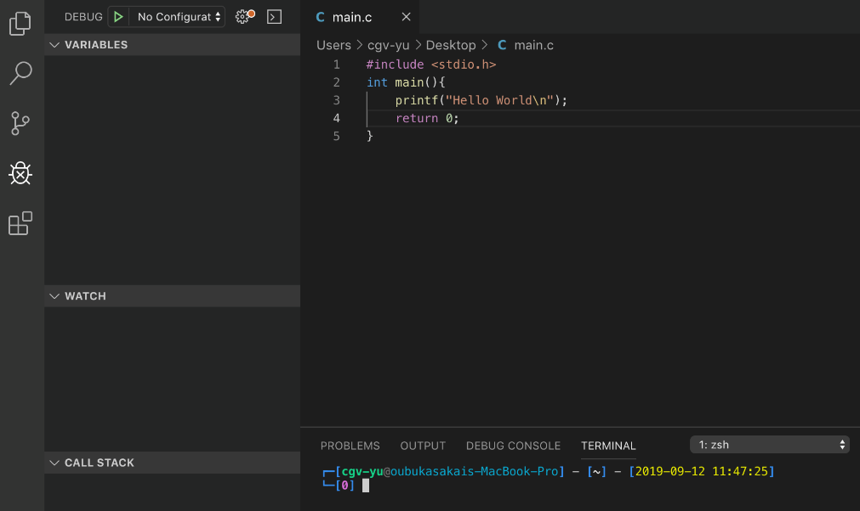
Vs code usage
Step3: Write your program and open terminal
1. file name
3. open panel
1. write program
2. choose path to save
2. open debugger
3. save file
4. open terminal

Slide 11
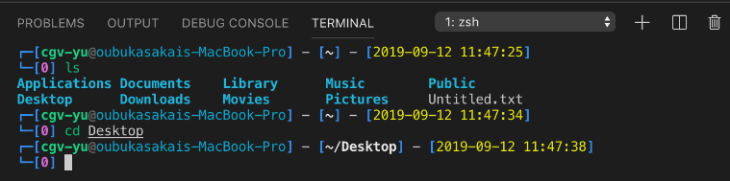
Vs code usage
Step4: Using terminal to compile your code (part1 --- basic command)
⇒ ls : list files
⇒ cd : change directory (go to specify directory)
⇒ ./ : current directory
⇒ ../ : parent directory
2. choose path to save
list files
3. save file
go to Desktop
Reference: http://www.informit.com/blogs/blog.aspx?uk=The-10-Most-Important-Linux-Commands

Slide 12
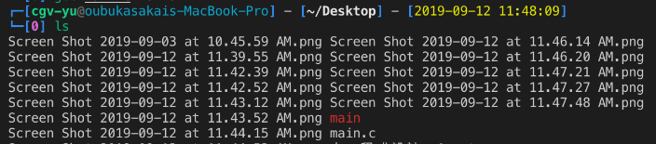
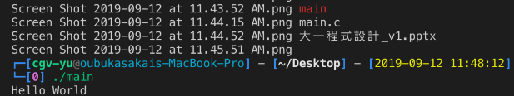
Vs code usage
Step4: Using terminal to compile your code (part2 --- gcc compiler)
the current directory
list files
the c file your saved
⇒ gcc : c compiler
⇒ gcc main.c -o main : compile main.c to main (execute file)
2. choose path to save
list files
3. save file
go to Desktop
./main ⇒ execute main to show the result
Reference: https://www.thegeekstuff.com/2012/10/gcc-compiler-options/?utm_source=feedburner

Slide 13
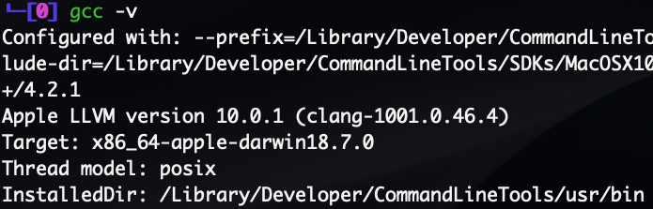
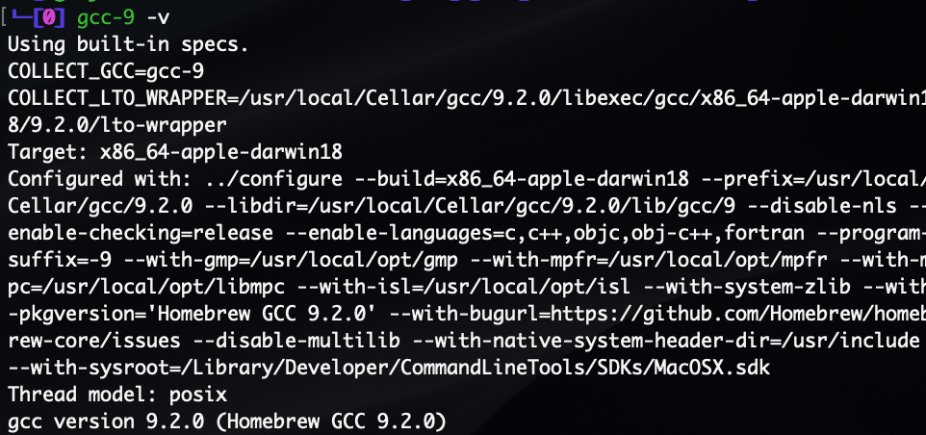
Vs code usage (about gcc)
You can use “gcc -v” in command line to get the basic information
Note that if you want to use gcc download by homebrew, you need to change use “gcc” to “gcc-9”
Default gcc (clang)
(gcc install by homebrew)
ruby -e "$(curl -fsSL https://raw.githubusercontent.com/Homebrew/install/master/install)"​
brew install gcc

Slide 14
Enjoy to program your code!

